Slide 1
Intro to Neural Nets
Session 6: Working with Text

Slide 2

Session Agenda
Background on NLP
Use Cases
Quick review on bag of words approaches, etc.
TextVectorization Layer
This implements basic standardization and punctuation removal. It assumes 1-grams, then one-hot encodes.
No stemming or stop word removal, by default.
Sequence vs. Bag-of-Words
Conceptually
Architectures for Sequences
Bidirectional LSTM

Slide 3
Quick Review of NLP Concepts
Pre-processing Text
Standardization, stop words, stemming, tokenization (words), n-grams.
One-hot-encoding / vectorization.
Final state is often a Term-Frequency Matrix
Q: why is this called a bag-of-words approach?
 | Database | SQL | Index | Regression | Likelihood | linear
D1 | 24 | 21 | 9 | 0 | 0 | 3
D2 | 32 | 10 | 5 | 0 | 3 | 0
D3 | 12 | 16 | 5 | 0 | 0 | 0
D4 | 6 | 7 | 2 | 0 | 0 | 0
D5 | 43 | 31 | 20 | 0 | 3 | 0
D6 | 2 | 0 | 0 | 18 | 7 | 6
D7 | 0 | 0 | 1 | 32 | 12 | 0
D8 | 3 | 0 | 0 | 22 | 4 | 4
D9 | 1 | 0 | 0 | 34 | 27 | 25

Slide 4
Weighting Term-Documents: TF-IDF
Not all phrases are of equal importance…
E.g., David less important than Beckham
If a term occurs all the time, observing its presence is less informative
Inverse-document frequency (IDF) helps address this.
Term ‘weighting’ is then calculated as Term Frequency (TF) x IDF
n_{j}= # of docs containing the term, N = total # of docs
A term is deemed important if it has a high TF and/or a high IDF.
As TF goes up, the word is more common generally. As IDF goes up, it means very few documents contain this term.

Slide 5
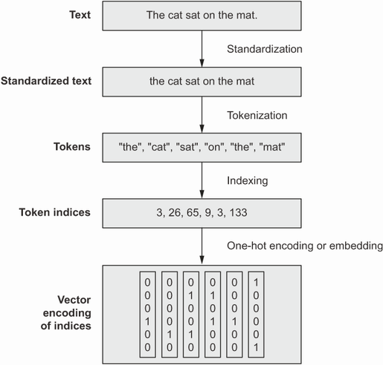
TextVectorization Layer
Pre-processing Text
Standardization, tokenization (words), one-hot-encoding / vectorization.
The Keras TextVectorization() layer achieves these steps quickly.
Customization
You can work with n-grams, and do other sorts of pre-processing, using arguments.
Options
Include as part of TF Dataset pipeline (more efficient)
Include as a layer in your Keras model.

Slide 6
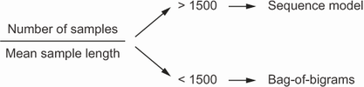
Sequence vs. Bag-of-Words
Word-Ordering Contains Information
We can get a weak representation of language sequences using n-grams, but this can be limited.
Sequence-models may provide leverage more information from language in prediction tasks (if we have enough examples, and the sequences are short enough).
We can represent these sequences with RNNs, typically bidirectional RNNs (because word ordering and interpretation is not always linear).

Slide 7
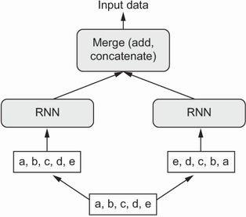
Bidirectional LSTM
We Saw This Last Time
Take each sequence as input data, as well as a flipped/reversed copy.
Was state of the art for text processing until relatively recently (transformers now dominate).
Instead of Time Series We Pass…
Sequences of one-hot-encodings of terms.
Sequences of pre-trained vector embeddings of terms.

Slide 8
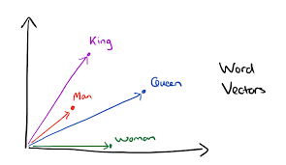
Embedding Layer
LSTM Will Still Struggle to Figure Out Semantics
Despite having sequence, it will struggle with synonyms, grammar, concepts.
Textual Embedding Layer First Provides Dimensionality Reduction
Cast words into a latent dimensional space – similar vector = similar meaning.
The Embedding layer is a lookup table that maps tokens to vectors. The vector associations are weights in the network, randomly initialized. Network updates them to learn dimensionality reductions that help with prediction (just like with convolution filters).
We can pass the output sequences of learned vector representations into our LSTM.
Notes:
Available pre-trained embedding layers (e.g., trained on Wikipedia page data), but you can also fit these models on your own corpus of text, to learn context-specific embeddings.

Slide 9
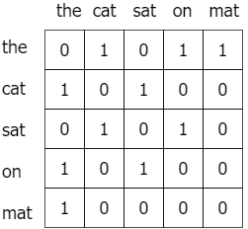
Pre-Trained Embeddings: GloVe
Global Vector Representation
Based on a giant term-term co-occurrence matrix – rows are vectors of co-occurrence (conditional) probabilities.
Two terms are similar if their ratios of co-occurrences with other terms are about equal.
Roughly speaking, GloVe learns word vectors, e.g., v_i and v_j, such that the dot product of any pair of vectors is equal to their co-occurrence ratio P(v_j | v_i).
This is achieved via a gradient-descent optimization.
Notes:
Available pre-trained embedding layers (e.g., trained on Wikipedia page data), but you can also fit these models on your own corpus of text, to learn context-specific embeddings.

Slide 10
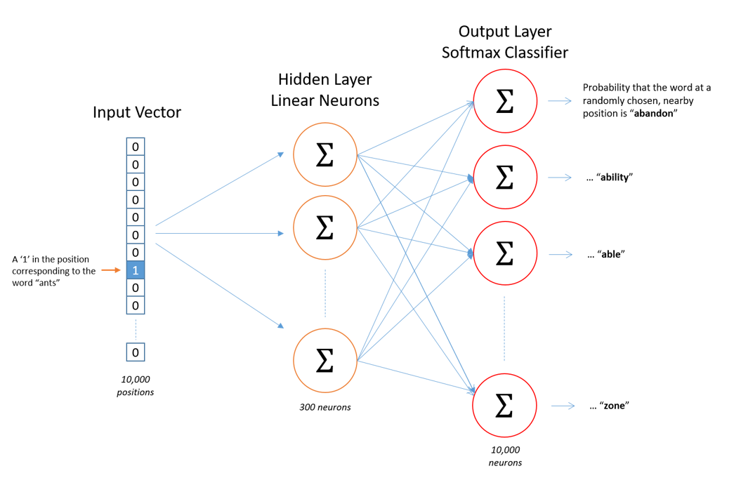
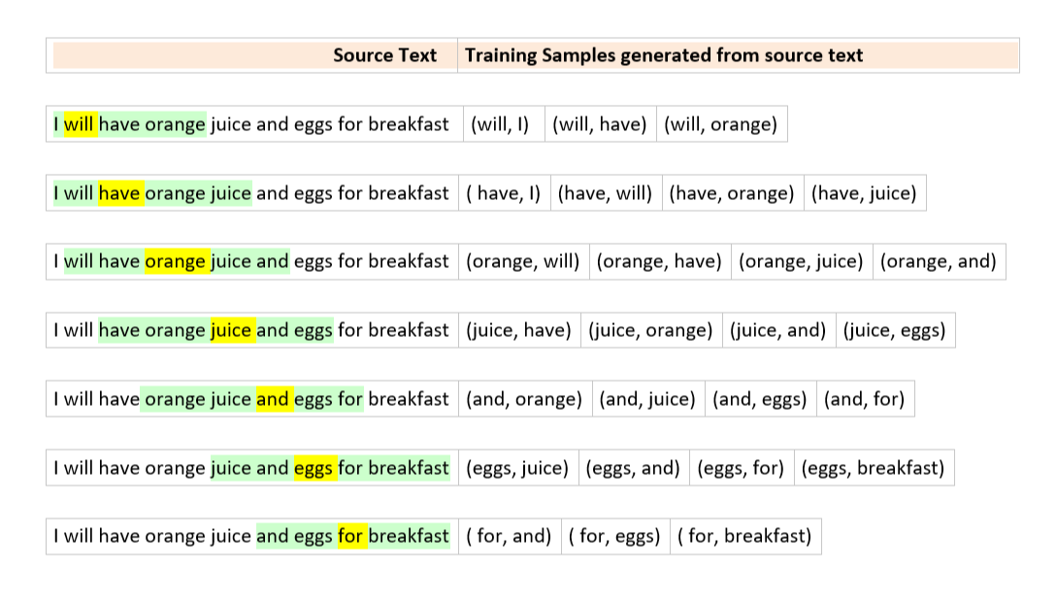
Pre-Trained Embeddings: Word2Vec
Word2Vec
Two types: CBoW and Skipgram
Construct training examples and labels.
Notes:
This is skipgram on the right. One word to surrounding context words (we map input word to

Slide 11
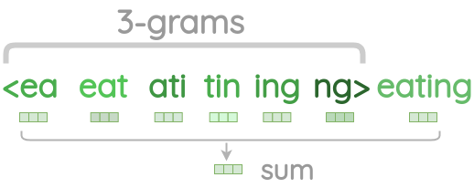
Pre-Trained Embeddings: Limitation
Out of Sample Words
Both GloVe and Word2Vec are limited to words you’ve seen before in training. They cannot handle new words. Those words thus get omitted / dropped, or you need to do something different.
FastText
An extension to Word2Vec which learns character n-grams of words. So, instead of embedding words, we embed portions of words (e.g., a 3-gram character representation would break up the word ‘coffee’ into ‘cof’, ‘off’, ‘ffe’, … and then learn vector embeddings of each.
Notes:
This is skipgram on the right. One word to surrounding context words (we map input word to

Slide 12
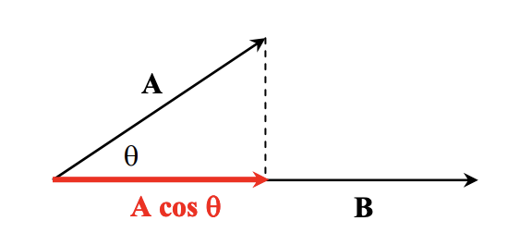
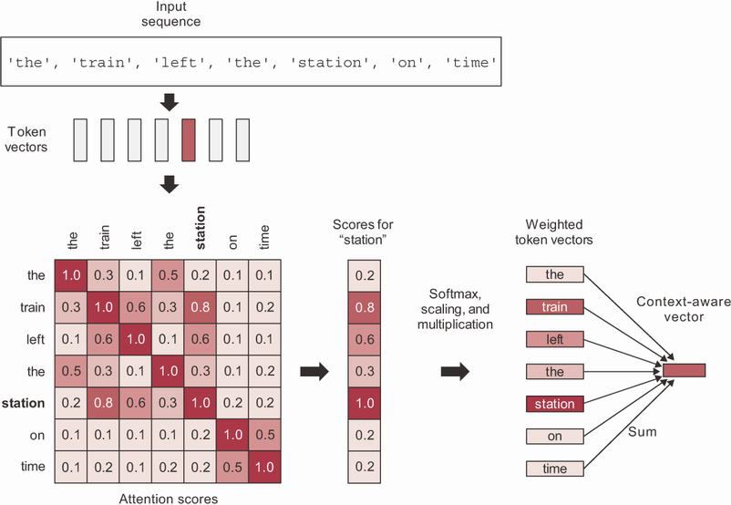
Attention (Building Block of LLMs)
Drawback of LSTM: Tries to Memorize Everything!
BUT: some pieces of a sequence are more important than others for understanding values at a particular position.
Self-attention Layer: a dense layer that takes sequences of values as input and implements some mechanism to figure out weights that can be used to amplify or attenuate sequence elements.
Basically, it gives the network a way to shift focus to certain items that are useful
Notes:
Attention layers are a very general concept. They are also implemented in many ways, using custom layers in Keras, for example, or using pre-defined layers. The book gives one example of an attention mechanism, Self-Attention, which is based on vector dot products between words’ vector embeddings. Just understand that this is merely one example of attention, and it’s not how every attention layer works.
Matrix on the left is the result of taking dot products between word (e.g., on the row index, station) and every other word (column index) (this is imaginary). We then take the resulting values and scale them / run them through a softmax. This will yield values 0-1, that sum to 1. Last step is to multiply those scores by all the associated term vectors in the sequence, and then add them together. The result is a new ‘shifted’ word vector for ‘train’, which is ‘context aware’ (of other items in the sequence with it).
Remember, vector dot product is project of A onto B. So, if two words are orthogonal in embedding space (they are completely unrelated) then the dot product with be 0. If two words are parallel, it means they are semantically related, and their dot product will approach 1.

Slide 13
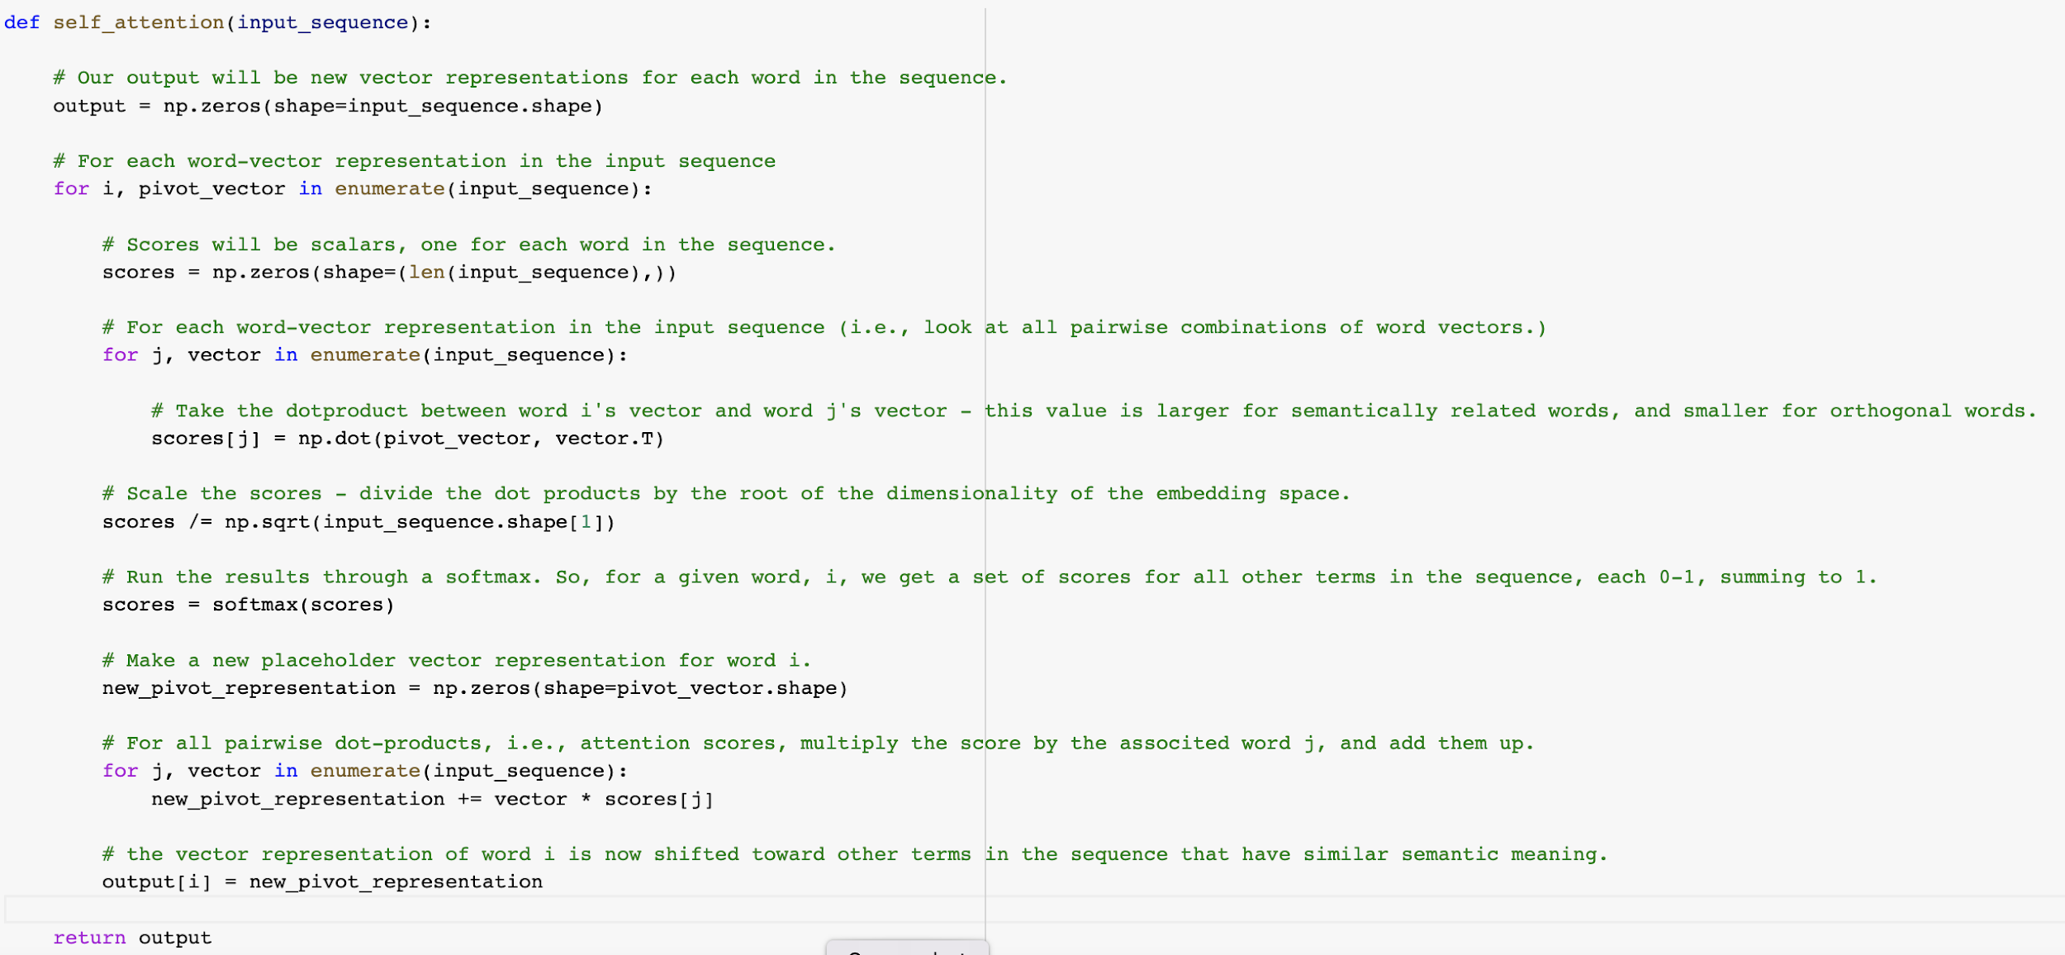
Self-Attention Layer

Slide 14
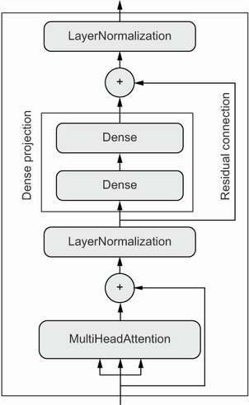
Transformer Architecture
Implement Multiple, Parallel Attention Mechanisms
This allows the model to figure out different ‘types’ of attention patterns.
So, maybe the model should pay attention to word 1 and word 4 for one ‘reason’ and it should pay attention to word 3 and word 8 too, for a different ‘reason’.
Transformer Builds on Multi-Head Attention
It stacks the parallel attention layers with normalization layers and dense layers, plus some residual connections to enable better gradient updates.
LayerNormalization() normalizes within sequence, instead of across the batch.

Slide 15
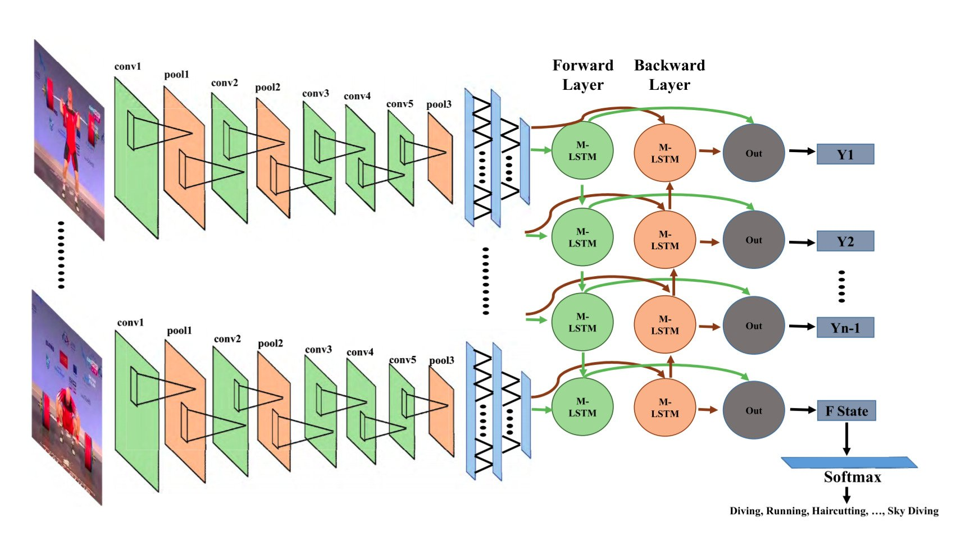
CNN-RNN for Video
Hybrid Topology for Image Sequences
We Use CNN’s to detect features at a given input.
We feed those feature maps into an RNN architecture, like LSTM.
We can use this topology to predict things about videos.
You might pre-process frames using a pre-trained CNN and pass feature maps as sequences to an RNN.
Notes:
This is skipgram on the right. One word to surrounding context words (we map input word to

Slide 16




Other Generative Models
Generative Models Have Taken Off
Text-to-Image: Midjourney, Stable Diffusion, DALL-E, etc.
Audio + Photo to Video: D-ID
Text to Voice: ElevenLabs
Notes:
https://twitter.com/JackPosobiec/status/1630263716473077766?s=20

Slide 17
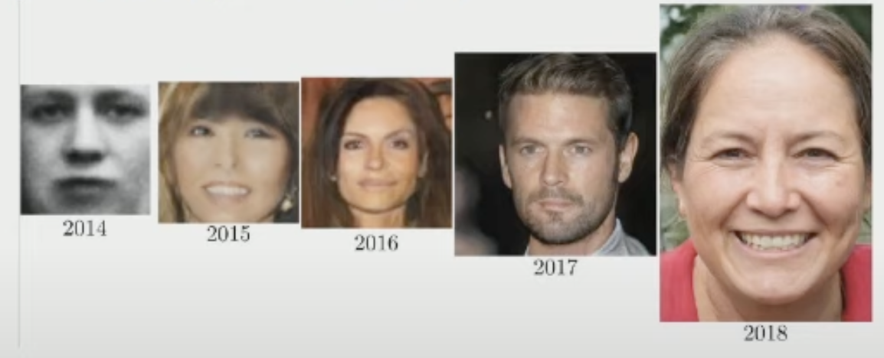
Generative Adversarial Networks (GANs)
GANs are a Powerful Flexible Tool for Generative Modeling
What is a GAN? How do GANs work?
What problems can we address with GANs?
How do we implement a GAN?
Notes:
https://www.youtube.com/watch?v=G06dEcZ-QTg

Slide 18
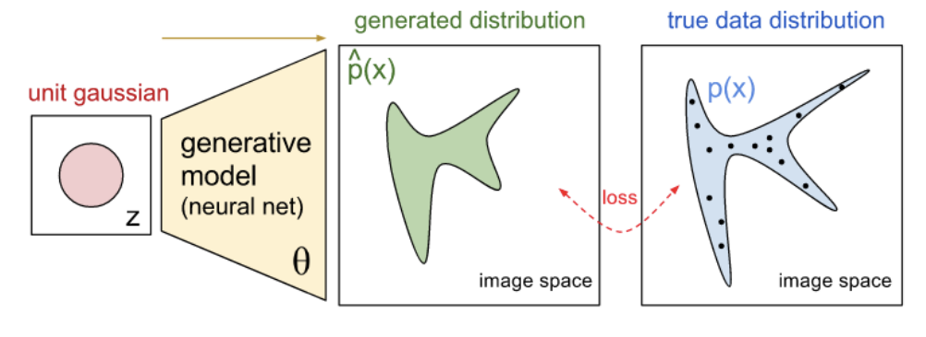
The Goal of a GAN
Synthesize Samples That Conform to the Real Data’s Distribution
We train a network to produce synthetic samples that are indistinguishable from true samples.
More concrete, this means we train a network to learn the probability distribution of real data.
For example, learn the joint probability distribution of pixel values in a set of images.
So, the resulting network could take a random vector of noise as input, and map it to a synthetic output that looks very similar to real data.

Slide 19
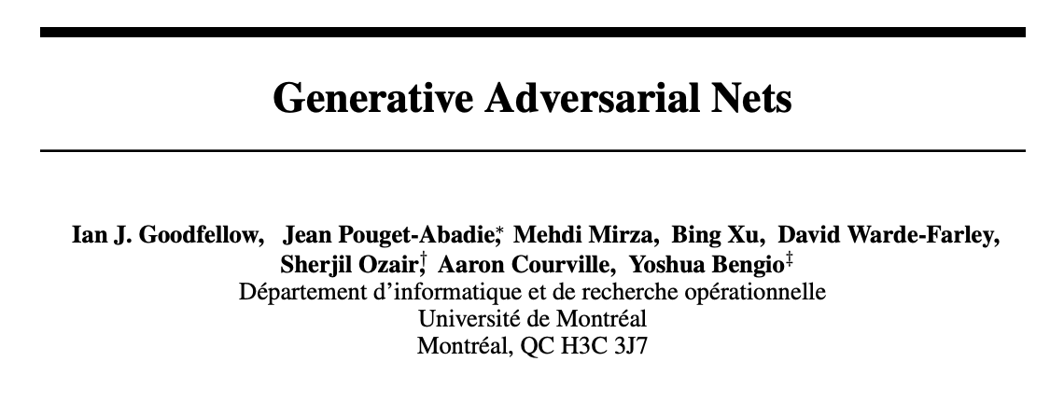
How Might We Do This?
A Neural Net That Produces Image Output
Take in a random vector as input, and have it produce image predictions.
Next, compare those predictions with real images. But how?
We don’t want it to try to predict a specific image, because then it won’t be able to produce new synthetic examples.
The problem? The loss function is extremely complicated.
A solution… `
Notes:
We pair a discriminator with the generator. Discriminator is a standard network we’ve seen before; it’s a classifier. It takes in an image, and predicts whether the image is real or fake.

Slide 20
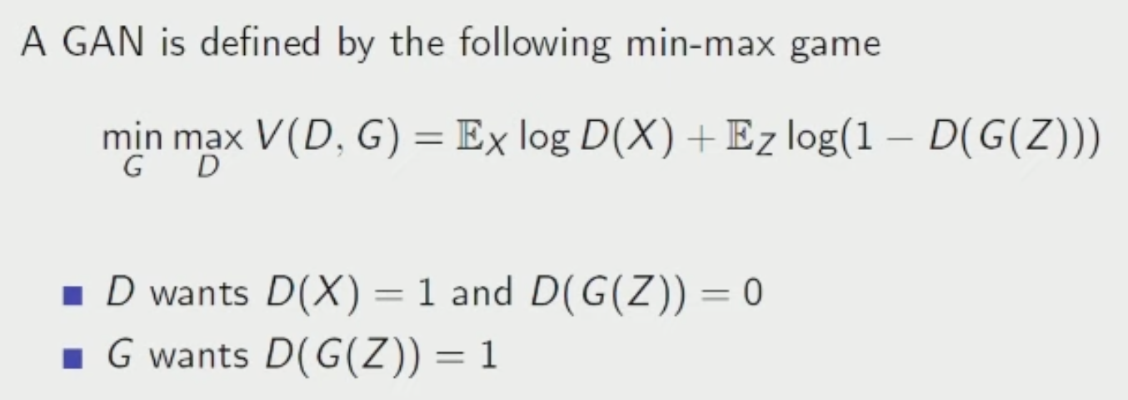
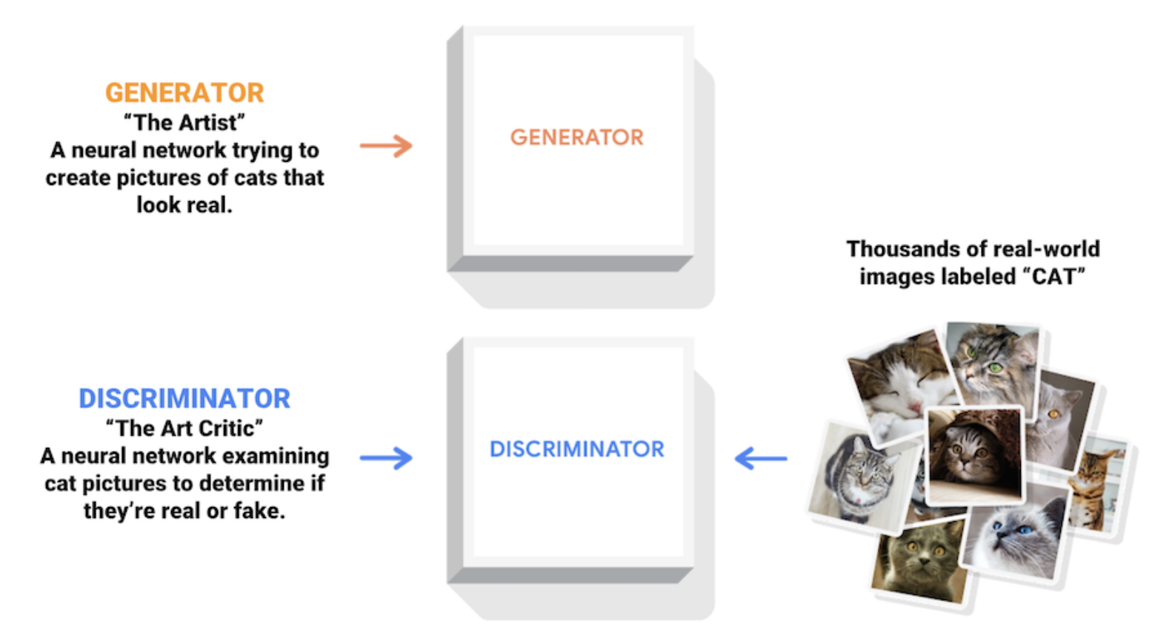
Adversarial Architecture
Discriminator
Serves as an adaptive loss function for the generator.
It’s a throw-away network that is just there to help train the generator.
Notes:
We pair a discriminator with the generator. Discriminator is a standard network we’ve seen before; it’s a classifier. It takes in an image, and predicts whether the image is real or fake.

Slide 21
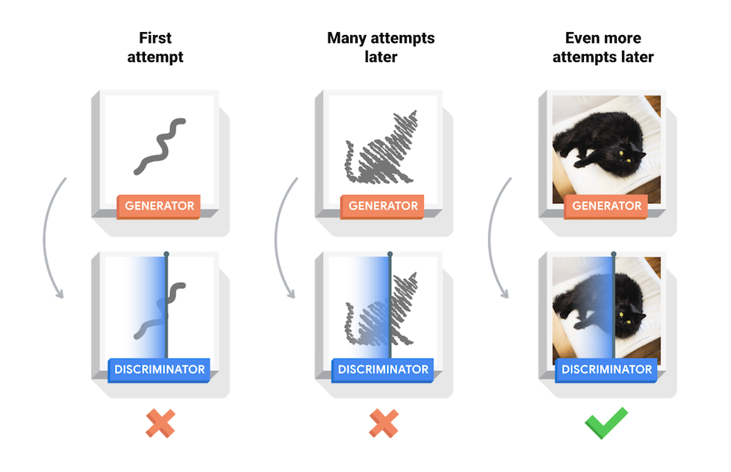
Adversarial Architecture
Notes:
We pair a discriminator with the generator. Discriminator is a standard network we’ve seen before; it’s a classifier. It takes in an image, and predicts whether the image is real or fake.

Slide 22
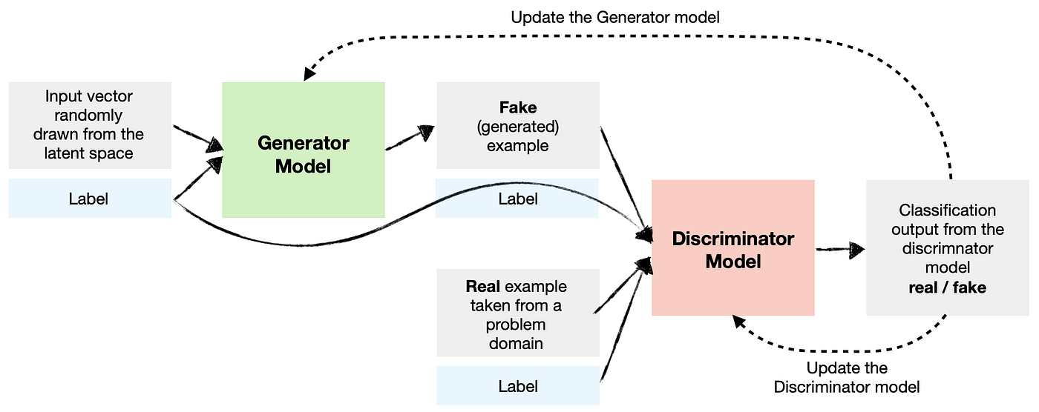
Conditional GANs
GAN /w Labels as Input Too
We don’t want our GAN to just learn P(X); it needs to learn P(X|Y).
This is a simple modification; we give two inputs to the generator, a label and a noise vector. So, it tries to produces images that match real images given a particular label, rather than images in general.
End result is a generator that you can pass a noise vector and a label, and it spits out an image of that label.
Notes:
We pair a discriminator with the generator. Discriminator is a standard network we’ve seen before; it’s a classifier. It takes in an image, and predicts whether the image is real or fake.

Slide 23
Questions?
Notes:
Weights are not initialized until you “build” the model (or compile it, which will first build).

